Slide 1
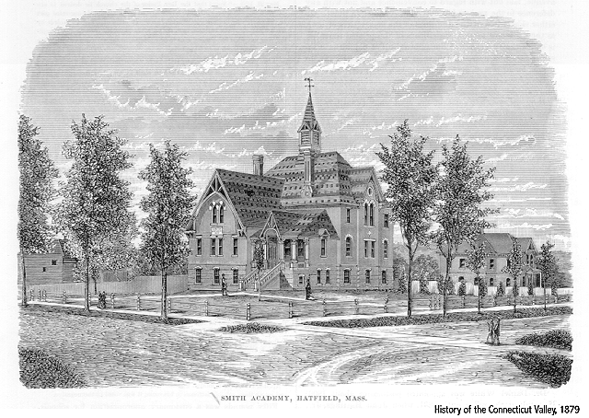
Focus on
Instructional Practice
Hatfield Public Schools August 29, 2017
Debra Block, Ph.D. Teachers21.org

Slide 2
AGENDA
How Can What We Know Change?
Growth, Reflection, and Goal Setting
How Do We Start?
June
Danger of a Single Story
Impatient Problem Solving
Pass the Baton
Next Steps

Slide 3
Value of Cooperative Learning
STUDENT ENGAGEMENT/ACTIVE LEARNING
PROCESS BEFORE PARTICIPATION
CHECKS FOR UNDERSTANDING
DIFFERENTIATION
INTENTIONAL GROUPING
Notes:
Start with small bites

Slide 4
T.A.P.S.
Questions:
Which approach for which task?
Which goal?
Which student?
Match task to goal
Match task to goal (yes--there twice for emphasis)
Total class
Alone
Partners
Small Groups

Slide 5
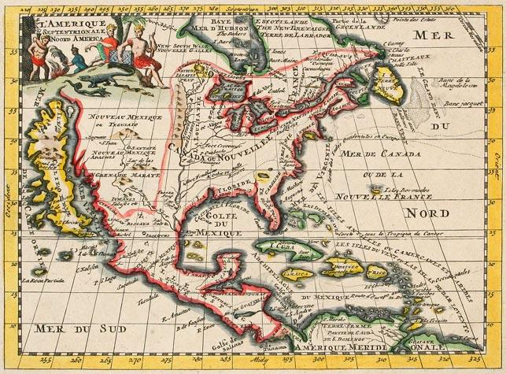
See
Think
[Justify]
Wonder
Notes:
Do See-Think-Wonder

Slide 6
Imagine What You’ll Know Tomorrow
https://www.youtube.com/watch?v=2w0fInUhtnk
Notes:
Why We Teach

Slide 7
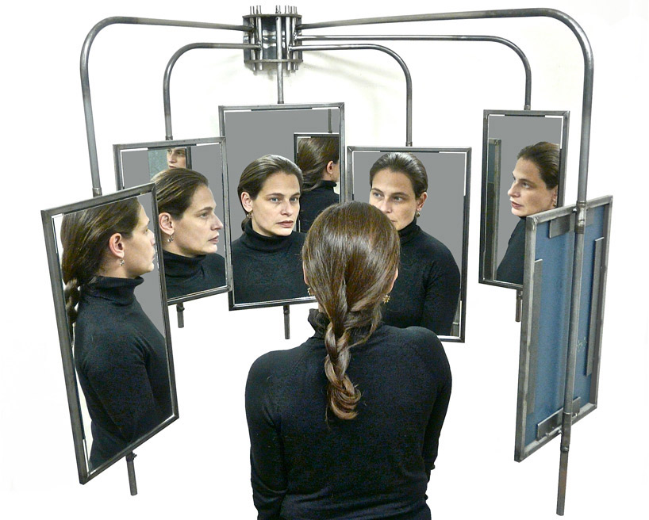
Getting into the 360°

Slide 8
For MY eyes only!
Me: 8/29 | Me: Year 1 | Supervisor | Colleague | Beloved Student | Challenging Student
3 adjectives that the person at the top of the column would use to describe you as an educator…

Slide 9
The Growth Model
What does it mean to learn?
What does it mean to be smart?
What does it mean to do well?

Slide 10
What’s the difference?
I like how you’re doing that.
Great approach to that project.
Great throw.
Great job on that project.

Slide 11
“One is to focus on the process of living healthfully rather than the goal of being healthy. A recent University of Zurich study tracked the progress of 126 dieters and found that the more weight the subjects lost in any given week, the less weight they would lose (or the more they would gain) the following week. But this rebound effect was weakest when the subjects homed in on the process of changing their eating behavior rather than on the outcome of losing weight or improving their appearance.”
New York Times, October 25, 2015
How Salad Can Make Us Fatter

Slide 12
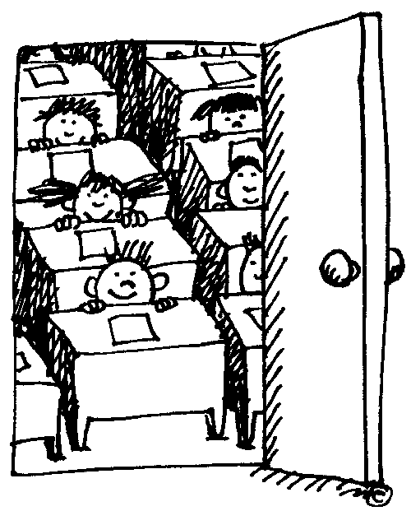
Good Job Mommy
WHAT IS GROWTH??

Slide 13
Learning Strategy: The Final Word
1. Assign reading. Ask students to highlight two to three items in their reading that were most interesting or thought-provoking. This can be assigned as work outside of class.
2. Formulate groups. All people within each group should have read the same article or section.
3. In turn, each individual shares one of the items they highlighted, but does not comment on it. When sharing their item, it is helpful to give page, column, and paragraph info so the item can be quickly found by everyone in the group. To share the item once people have found it, simply read it.
4. Starting to the left of the person who shares the item, group members comment, one at a time, in round-robin order about the item. It is important that there is no cross talk.
5. The person who initially shared the item then shares his/her thinking about the item last, getting the final word.
6. Repeat the pattern so that each group member gets an opportunity to initiate an item from their highlighted list.
What is interesting about the Final Word process is that the person who initiates the item may have a completely different perspective about it once others have all commented on it.
This process is excellent for helping people see others’ perspective, developing listening skills (no cross-talk), and challenging assumptions.

Slide 14
The I. T. P
Fill in the Final Column
What Adjectives Would You Like To see on Your List in June??

Slide 15
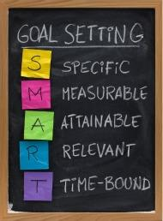
SMART GOALS

Slide 16
How to Jigsaw
Divide into groups and have each group take on one component of a story, article, subject content, etc. Each group masters its content and decides on the best way to present its area of ‘expertise’.
Works as a great way to review elements of fiction, subject area content, steps to solve a problem.
It allows students to go deep, take ownership, and demonstrate mastery.

Slide 17
WHERE DOES THE STORY BEGIN??
1. please read the selection you have been given
2. be prepared to explain to the other groups how the story of the Williams family began in the location described in your reading
3. note any questions you have

Slide 18
WHERE DOES THE LEARNING BEGIN??
Now think about the students in your class.
Where does their story begin?
Do all of their stories begin in the same place?
Do a Turn and Talk. Briefly discuss where the story begin for the students in your class.
There are no right or wrong answers here.
Be prepared to present your partner’s answer to the group.

Slide 19
CHALK TALK
Each table (spot) will be a possible starting point for a conversation/topic/issue
Using your marker, write down your thoughts/questions/concerns
Read the comments of others at your table--you may reply to their comments, ask questions, or offer other observations
Chalk Talks are SILENT ACTIVITIES
Please be respectful of the opinions of others
Time permitting, you will rotate to all of the table, eventually returning to your ‘home’ table

Slide 20
WHERE DOES THE TEACHING BEGIN??
The items below are possible STARTING POINTS for a lesson. What are the first things you might do do with your students?
Critical Thinking
Differentiation Decisions
Content Acquisition
Skill Acquisition
Use of Technology

Slide 21
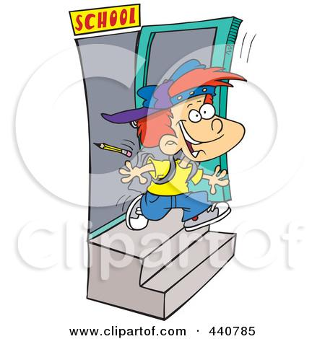
JUNE
What would it break your heart if your students left your room in June not knowing, not understanding, not being able to do????????
ould it

Slide 22
The Danger of a Single Story:
Chimamanda Adichie TEDTalk
http://www.ted.com/talks/chimamanda_adichie_the_danger_of_a_single_story
Is there a danger of a single story in what you teach?
How might it affect your instructional practice?

Slide 23
PATIENT PROBLEM SOLVING
-https://www.youtube.com/watch?v=NWUFjb8w9Ps
As you watch the following video,
Consider the way we usually ask students questions in Math.
What is the speaker’s critique of this process?
What does Impatient Problem Solving look like in your discipline? (even if you don’t do it)

Slide 24
PATIENT PROBLEM SOLVING
What Does Patient Problem Solving Look Like in Your Discipline?
How Might It Affect Your Instructional Practice?

Slide 25
Lesson Planning Activity: Model
Smart Phone Literature Project https://betterlesson.com/user/329122/60574/155760/dr-elizabeth-watts-bromery/curriculum

Slide 26
Lesson Planning Activity: Practice
Using one of the following Complex Texts, create a lesson or use one of the following:
Uncle Sam’s Family Tree, https://collections.leventhalmap.org/search/commonwealth:3f463673h
Whale Chart, https://www.loc.gov/rr/hispanic/portam/img/whaleall2.jpg
Ordeal by Cheque, http://ghsbears.pbworks.com/f/Cheques.pdf
Comparing Six European Metro Systems, https://s-media-cache-ak0.pinimg.com/736x/32/4d/05/324d05e69154a8c8c91c06e46a215cd0--public-transport-transportation.jpg
Massachusetts Population and Elector Graph, 1790-2010,
http://maps.bpl.org/sites/default/files/Massachusetts_Population_and_Electoral_College.jpg
STATE PERCENT OF OVERALL US POPULATION AND ELECTORAL VOTES BASED ON 2010 CENSUS (Handout )

Slide 27
NEXT STEPS

Slide 28
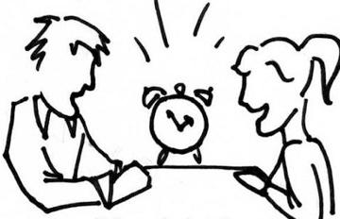
Speed Dating
Our topics:
Try Something New (Favorite Teaching Strategies)
Reflect on Your Practice
Visit a Colleague
Have Debra In to Model/Co-Teach

Slide 29
HOW TO FACTOR ASSESSMENT INTO GRADING (ONE POSSIBLE MODEL)
(X%) | (Y%) | (Z%)
Participation | Progress | Performance
Attends Class Each Day Follows Directions. Shares Writing Regularly Offers Constructive Feedback to Others Maintains a writer’s notebooks Completes Portfolio requirements | Improves in ability to: Use writing strategies independently Know when own writing needs to be revised Edit own writing and the writing of others Choose good writing topics Write in different forms | Produces writing that is equal in quality to the best writing of other students at this grade level Quality is determined by reference to authentic student writing samples and classroom writing criteria
THE THREE P MODEL OF GRADING

