Slide 1
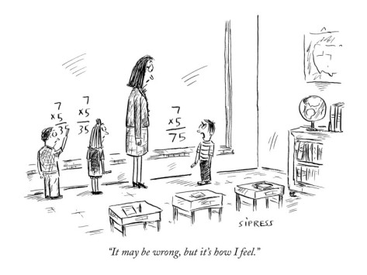
Questions, Assessment, and Feedback
HATFIELD
PUBLIC
SCHOOLS
November 9, 2017
Debra Block, Ph.D.
Teachers21.org

Slide 2
AGENDA
I. Ice Breaker
II. Questioning Strategies
III. Inviting Uncertainty into the Classroom
IV. Assessment
V. Feedback
VII. Next Steps
Notes:
From exit ticket--what you wanted to work on

Slide 3
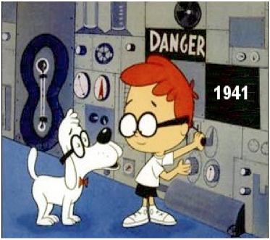
Where Were We????

Slide 4
WHAT/SO WHAT/NOW WHAT?
Please reflect on your own about the work we did at our August training using the lens: What/So What/Now What? Write your thoughts on the stickies provided.
Post your thoughts in the parking lot.
TS: Gallery Walk

Slide 5
As you watch this clip
WHAT ONE QUESTION DOES SHE ASK REPEATEDLY??
What is the objective of this lesson?
What do you conclude about her as a teacher from these questions?
What message does she convey to her students by these questions?

Slide 6
How Did We Get Here?
What was my objective (short term)
What were my long term goals?
What might one conclude about me as a teacher based on this question?

Slide 7
Identify a question
that you ask frequently
What is your objective (short term)
What are your long term goals?
What might one conclude about you as a teacher based on this question?
PAIR-SHARE

Slide 8
“Here is Life, an experiment to a great extent untried by me; it does not avail me that they have tried it.”
Walden, Henry David Thoreau

Slide 9
Higher Order Thinking Skills
Baseline Order Thinking Skills
HOTS v. BOTS

Slide 10
THE SCIENTIFIC METHOD: The Place to Begin

Slide 11
KEY COMPONENTS
The Power of Observation
Facts first
Then Questions
Test the hypotheses
Fine tune
Present findings

Slide 12
Design an Experiment
What is an observation you have made about something in your ‘universe’?
What question does it make you ask?
How would you design an experiment to get an answer to this question?
What would be your hypothesis?
How might you test it? What information would you gather?
What new questions might you have?

Slide 13
INTEGRATIVE QUESTIONING MODEL
TEXT DEPENDENT Question can be answered using everything ‘in front of you’—the book, the problem, the experime | TEXT EXTENDER One hand on the text, the other reaching out
ANALYTIC Brings together several pieces—but posed BY THE TEACHER… | CREATIVE Also brings together several pieces, but generated BY THE STUDENT and demonstrates internalization of the concepts/ideas taught

Slide 14
Text Dependent Questions
What Constitutes Text?
Why do we need these questions?

Slide 15
Going From Text Dependent to Text Extender Questions
What Constitutes Text?
How do we extend from the text??

Slide 16
Going From Text Dependent to Text Extender Questions
Final Jeopardy Question, Semifinal Round, Champions of Decades, 5/7/14
Category: Supreme Court Decisions
On December 20, 1956, the court’s ruling in Browder v. Gayle went into effect, bringing an end to this 381 day event.

Slide 17
Sample Questions
Text Dependent:
How is the cosmic microwave light like a dinosaur bone?
Text Extender:
Prior to the discovery of the cosmic microwave light, why was the Big Bang a theory?
Analytic:
How did the work finding the specific date for the Big Bang reflect the general process of the scientific method?
Creative:
Now that we know the age of the universe, what other questions might we be able to answer?

Slide 18
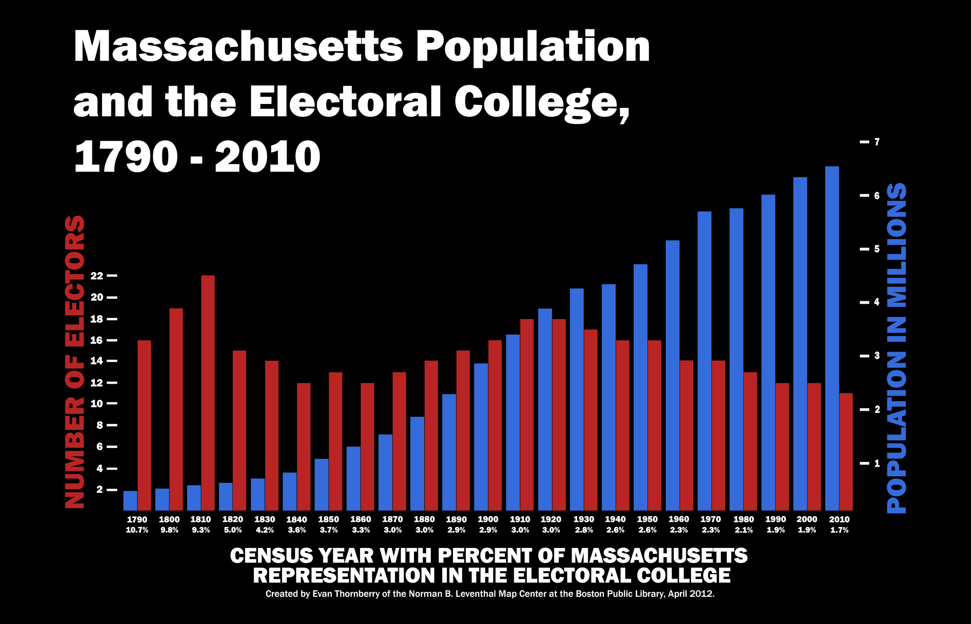

Slide 19
Sample Questions
Text Dependent: How many more electors did MA have in 1800 than it did in 1900? 2000?
Text Extender:
In what election did Massachusetts have its greatest influence in electing a president?
In terms of raw numbers, how much did the US population grow between 1800 and 1820?
Analytic: What is the impact within Massachusetts of its diminished role in the Electoral College?
Creative: Using this graph as evidence, argue for or against the elimination of the Electoral College as the way to elect the President.
Great web resource http://www.270towin.com/states

Slide 20
R.A.F.T

Slide 22
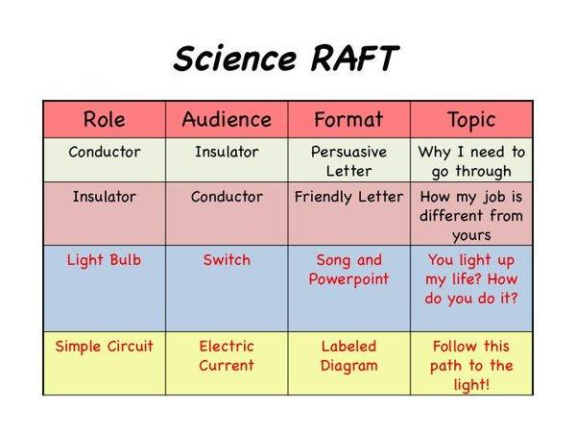

Slide 23
Numbered Heads Together
Numbered Heads Together is a cooperative learning strategy that holds each student accountable for learning the material.
Place students in groups and give each student a number (from one to the maximum number in each group).
The teacher poses a question and students "put their heads together" to figure out the answer. Or you may have the students write the questions (a nice opportunity to review close reading, questioning, etc) and submit and use those.
The teacher calls a specific number to respond as spokesperson for the group.
By having students work together in a group, this strategy ensures that each member knows the answer to problems or questions asked by the teacher. Because no one knows which number will be called, all team members must be prepared.

Slide 24
UbD Literally Boxes Us In
What Questions Do We Really Want the Answers to??

Slide 25
What Is A Map??

Slide 26
What is a Map? Resources
Ptolemy Map https://collections.leventhalmap.org/search/commonwealth:3f462s124
1690 World Map https://collections.leventhalmap.org/search/commonwealth:x633fb24z
Two China Maps
https://collections.leventhalmap.org/search/commonwealth:x633f9048
and https://collections.leventhalmap.org/search/commonwealth:x633f9803
What’s Up South, 2002, https://collections.leventhalmap.org/search/commonwealth:x633f954g

Slide 27
What Is A Map??
(it’s not about maps…)
Choice
Bias
Perspective
State of Knowledge
Narrative
The essential elements of all critical thinking

Slide 28
Dare to Disagree
Ted Talk Margaret Heffernan
https://www.youtube.com/watch?v=PY_kd46RfVE
Identify two or three big ideas that you heard.
What role does ‘Disagreement’ play in your discipline?
How can it be a force for a positive outcome?

Slide 29
What are appropriate ways your students/faculty might
DARE TO DISAGREE???
What Does Disagreement look like in Your Universe??

Slide 30
How to Jigsaw: Step #1
Divide into groups and have each group take on one component of a story, article, subject content, etc. Each group masters its content and decides on the best way to present its area of ‘expertise’.
Your may have students write questions to be used at a later time.
Works as a great way to review elements of fiction, subject area content, steps to solve a problem.
It allows students to go deep, take ownership, and demonstrate mastery.

Slide 31
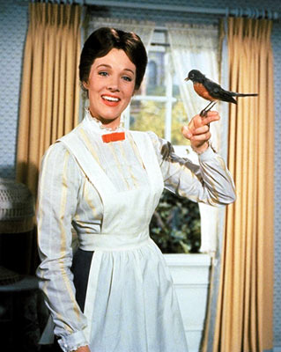
Well Begun is Half Done

Slide 32
How to Jigsaw: Step #2
Participants go from their initial groups into new groups where their now impart their expertise.
They are responsible to teach the members of the new group what they learned in Step #1

Slide 33
How to Jigsaw: Step #3
To check for understanding, use a questioning strategy.

Slide 34
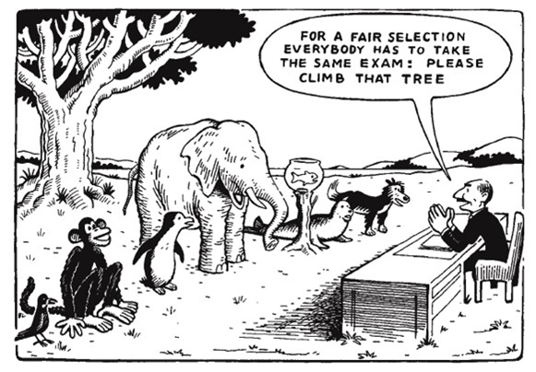
Assessment

Slide 35
What Is The Purpose of Assessment?

Slide 36
ASSESSMENT AS PART OF CURRICULUM DESIGN
Three Items to Consider:
What is the Next Step(s) with the Information Taught/Learned?
What is the Goal of the Assessment?
Matching Assessment to Goal
Notes:
--that the back and forth of curriculum design where knowing HOW students would be held accountable is an integral component with designing curriculum
But even more so, that assessment is part of the learning process, so it is considered as an integral curriculum element

Slide 37
What is the Next Step with the Information Taught/Learned?
Application/Practice/Ritual
Question
More Learning
Accept
Understand/Explain
[overlaps/multiple steps/gaps likely]

Slide 38
What is the Goal of the Assessment????
Content Mastery
Checks for Understanding
Reflection
Deepening Understanding
Direction for Future Learning
Notes:
Thinking it might be worth it revisit Bloom's Taxonomy here just to reflect upon goals--and that different content requires different levels/types of inquiry--this applies to II. exploring their sensibilities about the term Evaluate

Slide 39
BLOOM’S TAXONOMY
(to help match assessment to the goal…)

Slide 40
THE CASE OF THE BLACK DRESS

Slide 41
Connecting Formative Assessment to Goal(s)
Checks for Understanding
Active Engagement
Cooperative Learning
Genuine Differentiation
Deliberate Grouping
Process before Participation
Notes:
I guess the point I am hoping to convey is that we don't do an assessment just to do it, but because it is the best means to accomplish a goal

Slide 42
Connecting Summative Assessment to Goal(s)
Objective--Matching/Multiple Choice/Fill in the Blank
Essay
Performance
Problem Solving
Case Study
Notes:
I guess the point I am hoping to convey is that we don't do an assessment just to do it, but because it is the best means to accomplish a goal

Slide 43
INTENTIONALITY
INTENTIONALITY
Notes:
I guess the point I am hoping to convey is that we don't do an assessment just to do it, but because it is the best means to accomplish a goal AND BY DESIGN ON PURPOSE

Slide 44
Items to Balance
Notes:
Don’t always exist in opposition

Slide 45
Items to Balance
Ideals of Learning with Reality of Grades/Reports/College Admissions
Types of Knowledge
What Do You Want To Assess: Concepts/Skills/Understandings
Student Work: Effort/Accomplishments
Student Attitudes: Stress/Sense of Accomplishment
Grading Inconsistencies
Notes:
Don’t always exist in opposition

Slide 46
Process v. Product
Of Student Learning
Of Substantive Content
Of Assessing and Evaluating
Of Questions/Questioning
Notes:
Don’t always exist in opposition

Slide 47
Establish Criteria/Agreement?
Look at these MCAs questions (SMP, p. 7)
What grading criteria would you establish?
Would you scaffold/differentiate? If so, how?
Notes:
Don’t always exist in opposition

Slide 48
Establish Criteria/Agreement?
Please use the Student Responses I provide.
Grade INDEPENDENTLY!!
Compare your assessment with your colleagues’ results.
Did you agree??
Notes:
Don’t always exist in opposition

Slide 49
STEPS ALONG THE WAY
Each group will get the bare bones of a curriculum unit. Please create formative assessments for the unit. For each
Identify what you hope to learn from the formative assessment
Any scaffolding/variations you would include
How the results of the formative assessment will affect instruction
Please plan to present your assessment plan to the full group
Notes:
Don’t always exist in opposition

Slide 50
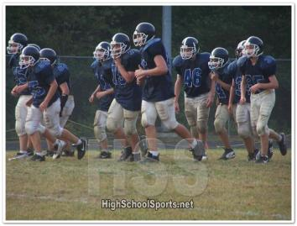
GO TEAM TO:
Connecting Feedback to Assessment

Slide 51
Appreciate
Coach Evaluate
What’s the Difference?

Slide 52
Appreciate, Coach, Evaluate
“Thanks for cooking dinner dad.”
“You’re a 3 star cook.”
“The soup could use a little more salt.”

Slide 53
Appreciate, Coach, Evaluate
Distinctions--which one do you want to give and why?
When and How
Responsibility of the Recipient

Slide 54
Appreciate, Coach, Evaluate
Role Play
Each Partner Take a Turn as Giving and Receiving Feedback at Monthly Check-in

Slide 55
The 3 R’s of Feedback
Three types of recipients:
Reactive
Receptive
Reflective
The following is from Building Teachers’ Capacity for Success – Pete Hall and Alisa Simeral
Notes:
‹#›

Slide 56
Reactive
A reactive recipient…
Hesitant to take ownership
Resistant to change
Limited knowledge of best practices
Does not always value feedback

Slide 57
Receptive
A receptive recipient…
Occasionally takes ownership
Hesitant to change
Awareness of best practices
Does not always implement the feedback

Slide 58
Reflective
A reflective recipient…
Takes complete ownership
Embraces change that positively impacts student learning
Possesses a wealth of knowledge of best practices and implements effectively
Thinks critically about the provided feedback and strives for continuous improvement

Slide 59
“Actionable vs. Not Actionable Feedback”
I enjoyed my visit to your class. Your students seemed off task during the lesson. The transitions were chaotic and students seemed confused about procedures.
During independent practice, 7 out of 22 students were off task (heads down, side conversations, drawing). It is important to ensure students have a clear understanding of the task and expectations prior to beginning independent work. Be sure you have the attention of all students when providing directions, have one or two students repeat your directions, and monitor immediately after the start of independent practice to ensure all students have begun to work.

Slide 60
Let’s go to the video tape...
Specific Clips (apologies that they are not all HS, but they will be useful nonetheless):
HS Math, https://www.youtube.com/watch?v=h6WJdsb0dfM
(Whole Brain--if you’ve never seen this, it is not everyone’s cup of tea)
HS History--drop in teacher, raw footage--https://www.youtube.com/watch?v=tZT7q4I8IcM
(also excellent)

Slide 61
More clips….
The following are highly edited, but still might provide some value
From Better Lesson: Grade 8 Math, http://betterlesson.com/lesson/434929/equivalent-expressions-formative-assessment-lesson-day-1-of-3
From Making Thinking Visible: Grade 12 ELA and Grade K: Art Appreciation-on a DVD

Slide 62
Even more clips….
Grade 5 SS: https://www.youtube.com/watch?v=_cC5jB5FS-Q
(really good one--raw footage)

Slide 63
NEXT STEPS
Exit Ticket: https://docs.google.com/forms/d/1-1_oqpix9uG6nAL0mueCyd9re531fDrrBtAsKtC2-Pk/edit

