Slide 1
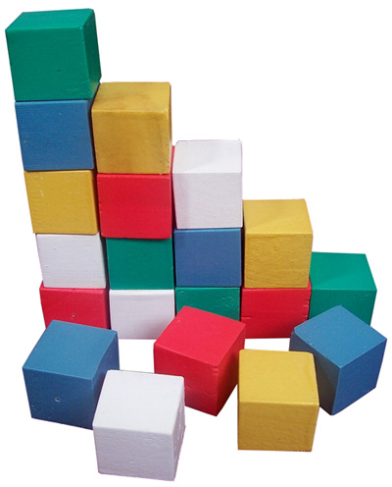
Saint Michael’s School
Let’s Get our Blocks in a Row
Debra Block, Ph.D.
Teachers21
August 31, 2016

Slide 2
Notes:
Do See-Think-Wonder

Slide 3
How Can What We Know Change??
https://www.youtube.com/watch?v=2w0fInUhtnk
Notes:
Why We Teach

Slide 4
Value of Cooperative Learning
STUDENT ENGAGEMENT
CHECKS FOR UNDERSTANDING
DIFFERENTIATION
DELIBERATE GROUPING

Slide 5
T.A.P.S.
Total class
Alone
Partners
Small Groups
Questions:
Which approach for which task?
Which goal?
Which student?
What is the best use of 83 minutes?

Slide 6
Compass Points
NEEDS
BLOCK Excitement
WORRIES SCHEDULING
Supports

Slide 7
How to Jigsaw
Divide into groups and have each group take on one component of a story, article, subject content, etc. Each group masters its content and decides on the best way to present its area of ‘expertise’.
Works as a great way to review elements of fiction, subject area content, steps to solve a problem.
It allows students to go deep, take ownership, and demonstrate mastery.

Slide 8
Numbered Heads Together
Numbered Heads Together is a cooperative learning strategy that holds each student accountable for learning the material.
Place students in groups and give each student a number (from one to the maximum number in each group).
The teacher poses a question and students "put their heads together" to figure out the answer. Or you may have the students write the questions (a nice opportunity to review close reading, questioning, etc) and submit and use those.
The teacher calls a specific number to respond as spokesperson for the group.
By having students work together in a group, this strategy ensures that each member knows the answer to problems or questions asked by the teacher. Because no one knows which number will be called, all team members must be prepared.

Slide 9
Where Does Our Story Start?
John Demos, The Unredeemed Captive, pp 3-9.
http://tinyurl.com/ofbbl4r
1. please read the selection you have been given
2. be prepared to explain to the other groups how the story of the Williams family began in the location described in your reading
3. note any questions you have

Slide 10
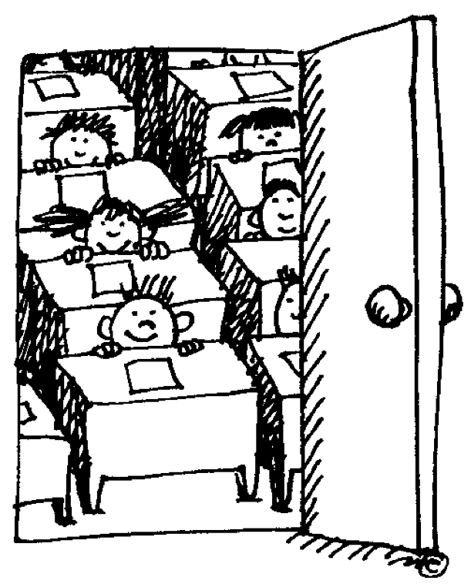

Slide 11
WHERE DOES LEARNING BEGIN??
Now think about the students in your class.
Where does the story of their learning begin?
Do all of their stories begin in the same place?
Turn to the person sitting to your right. Briefly discuss where learning begins in your classroom.
There are no right or wrong answers here.
Be prepared to present your partner’s answer to the group.

Slide 12
What’s the difference?
I like how you’re doing that.
Great approach to that project.
Great throw.
Great job on that project.

Slide 13
“One is to focus on the process of living healthfully rather than the goal of being healthy. A recent University of Zurich study tracked the progress of 126 dieters and found that the more weight the subjects lost in any given week, the less weight they would lose (or the more they would gain) the following week. But this rebound effect was weakest when the subjects homed in on the process of changing their eating behavior rather than on the outcome of losing weight or improving their appearance.”
New York Times, October 25, 2015
How Salad Can Make Us Fatter

Slide 14
When you learn a new kind of problem, it grows your math brain.
Not everybody is good at math; just do your best.

Slide 15
If you catch yourself saying you are not a math person, just add the word ‘yet’ to the end of the sentence.
That’s OK. Maybe math is not one of your strengths.

Slide 16
The feeling of math being hard is the feeling of your brain growing.
Don’t worry; you’ll get it if you keep trying.

Slide 17
The point isn’t to get it all right away. The point is to grow step by step. What you can try next?
Great effort; you tried your best.

Slide 18
Life-Liberating vs. Life-Limiting
Beliefs
All children are capable of high achievement; skills & abilities are developed through hard work & effective strategies (effort based ability)
You are not supposed to understand everything the first time around
Consistent effort is the main determinant of success
Mistakes help one learn
Smart students seek out assistance, resources, alternative pathways
Only the few bright can achieve at a high level (Intelligence is fixed at birth)
Speed is what counts;
faster is smarter
Inborn intelligence is the determinant of success
Mistakes are a sign of weakness
Smart students work independently

Slide 19
Life-Liberating vs. Life-Limiting Beliefs (Teachers)
All teachers are capable of teaching to the standard (Intelligence is malleable)
You are not supposed to understand everything the first time around
Skillful teaching can be learned
Mistakes help one learn
Successful teachers seek out assistance, resources, alternative pathways.
There are a few superstars (Intelligence is fixed)
Speed is what counts. Faster is smarter
Skillful Teachers are born
Mistakes are a sign of weakness
Successful teachers work independently. They don’t need any help.

Slide 20
Growth Mindset=Desire for Continuous Improvement
GROWTH (IMPROVING*) MINDSET
Moving From:
Proving ➔ Improving
Demonstrating Skills ➔ Developing New Skills
Being Better Than Others To ➔ Being Better Than You Were in the Past
*Heidi Grant Halvorson

Slide 21
Learning Strategy: The Final Word
1. Assign reading. Ask students to highlight two to three items in their reading that were most interesting or thought-provoking. This can be assigned as work outside of class.
2. Formulate groups. All people within each group should have read the same article or section.
3. In turn, each individual shares one of the items they highlighted, but does not comment on it. When sharing their item, it is helpful to give page, column, and paragraph info so the item can be quickly found by everyone in the group. To share the item once people have found it, simply read it.
4. Starting to the left of the person who shares the item, group members comment, one at a time, in round-robin order about the item. It is important that there is no cross talk.
5. The person who initially shared the item then shares his/her thinking about the item last, getting the final word.
6. Repeat the pattern so that each group member gets an opportunity to initiate an item from their highlighted list.
What is interesting about the Final Word process is that the person who initiates the item may have a completely different perspective about it once others have all commented on it.
This process is excellent for helping people see others’ perspective, developing listening skills (no cross-talk), and challenging assumptions.

Slide 22
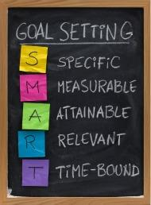
SMART GOALS

Slide 23
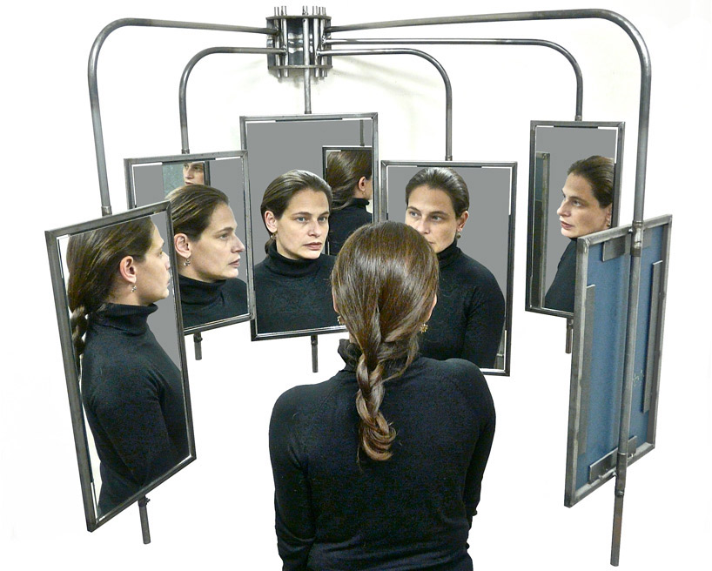
Getting into the 360°

Slide 24
Getting into the 360°
WHAT WOULD THEY SAY??
ME: TODAY | ME: YEAR 1 | COLLEAGUE | SUPERVISOR | EXCELLING STUDENT | STRUGGLING STUDENT
Curriculum Strengths Areas to Address

Slide 25
Thinking about your teaching
KNOW | DO | UNDERSTAND

Slide 26
CLOSE READING
What might we want to look for in each round?
Subject Matter
Goals
Enduring Understandings/Pedagogic Approach/Building Blocks

Slide 27
See How It Grows, PART 1 Step I: Traditional Unit
Select either Traditional Unit, ELA or Math, p. 4 in the Resource Packet.
Imagine giving this to a new teacher
Consider the Curriculum Elements: Content, Skills, and Concepts (Know/Do/Understand)
Is there anything missing?
What is the larger context for student learning?
Is there an Essential Question You Might ADD??
What is the Learning Experience Like for the Students?
What Is the Teaching Experience Like for the Teacher?
Do you have any guidance about long block teaching strategies based on the Unit?

Slide 28
See How It Grows, PART I:
Step II: Altered Unit
Now Look at the Altered Units (ELA, pp 7-8; Math pp 5-6) in the Resource Packet
Consider the Curriculum Elements: Skills, Concepts, Content (Know/Do/Understand)
What is the same? What is different?
How does including the Essential Questions, Transfer, and Evidence of Learning change the original assignment for the student?
How does it change the experience for the teacher?
Do you have any guidance about long block teaching strategies based on the Unit?

Slide 29
See How It Grows, PART 2
TRANSFER FROM UNIT TO UNIT
ESSENTIAL QUESTIONS | ENDURING UNDERSTANDINGS
STUDENTS WILL KNOW | STUDENTS WILL BE SKILLED AT
EVIDENCE OF STUDENT LEARNING
LONG BLOCK TEACHING RECOMMENDATIONS
Look at the seven blank boxes. Where should you begin? Think about building capacity across the grades within your department, the skill levels of your students. Does this change your response?Consider the realities of block scheduling and the gap in time between semesters. How does that affect where you start your unit? What you hope students will be able to DO? UNDERSTAND? KNOW?

Slide 30
Select One of the Following
Smart Phone Literature Project (HS ELA but can work in all grades/all disciplines)
http://betterlesson.com/lesson/589214/smart-phone-literature-project-day-one
Equivalent Expressions (Algebra 1)
http://betterlesson.com/lesson/434929/equivalent-expressions-formative-assessment-lesson-day-1-of-3
Mindset (Gr 6 Math)
http://betterlesson.com/lesson/473401/mindset
Weight-Mass-Gravity (Gr 5 Science)
http://betterlesson.com/lesson/626414/weight-mass-gravity
Types of Cells (Gr 7 Science)
http://betterlesson.com/lesson/629702/types-of-cells-part-1
Make Sense of the Electoral College (MS Social Studies)
http://mattersofeducation.org/materials_6-8/making-sense-of-the-electoral-college/
Narratives with Visual Images (Gr 4-6 Humanities)
http://mattersofeducation.org/materials_3-5/historical-narratives-with-visual-images/

Slide 31
AS YOU DO, PLEASE CONSIDER:
How is this lesson a good use of class time?
What else might the teacher have done to engage the students?
How might you apply to what you have seen here to a lesson?

Slide 32
NEXT STEPS

